Slide 1
ER Modelling

Slide 2
Introduction
When a person needs to make a functional DBMS certain steps must be follow-
Gathering information
Producing ERD
Designing the database
Normalization
Benefits of modelling
Focusing on essentials
Ease of communication and understanding
Product or process improvement
Exploring alternatives

Slide 3
ER Model
Model the information needs of an organization.
Gives the conceptual or logical view.
Provides communication between database designer and end user.
Provide an excellent source of documentation.
ER diagram can be modelled as-
Enitities
Relationship
Attributes

Slide 4
Entity
Distinguishable real world objects.
Ex-person,place,object,event etc.
An entity set is a collection of similar types of entities
Attributes
Descriptive properties possessed by all members of an entity set.
Attribute types:
Simple and composite attributes.
Single-valued and multi-valued attributes
Derived attribute.
Relationship
A relationship is an association among several entities.
Types of relationship-
Unary
Binary
Ternary

Slide 5
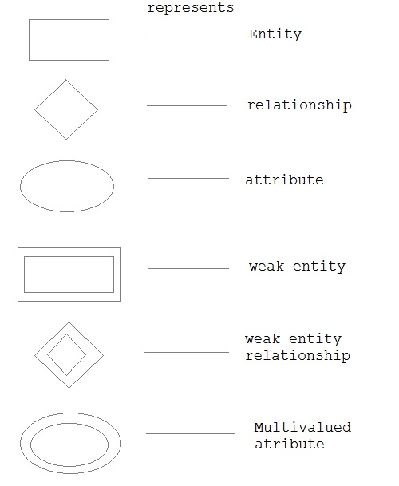
Symbols and Notations

Slide 6
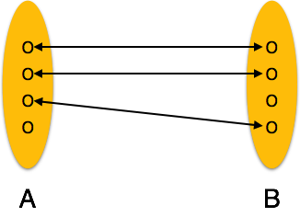
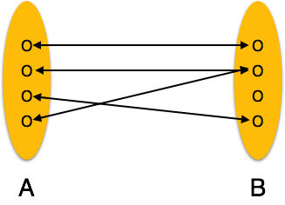
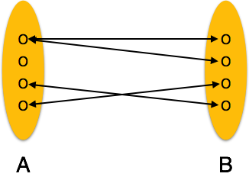
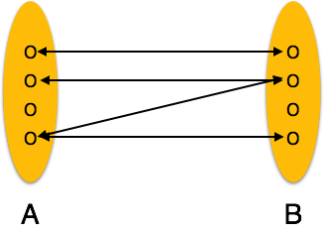
MAPPING CARDINALITIES
Cardinality ratio of a binary relationship is the maximum number of relationship instances that an entity can participate in.
One to one
Many to one
Many to many
One to many
We can also express cardinality constraints by drawing either a directed line (→), signifying “one,” or an undirected line (—), signifying “many,” between the relationship set and the entity set.

Slide 7
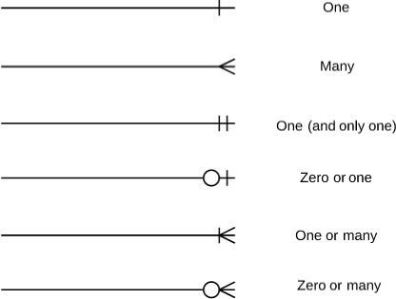
Notations

Slide 8
Keys
A super key of an entity set is a set of one or more attributes whose values uniquely determine each entity.
A candidate key of an entity set is a minimal super key
Customer_id is candidate key of customer
account_number is candidate key of account
Although several candidate keys may exist, one of the candidate keys is selected to be the primary key.
Primary key attribute represented by underline.

Slide 9
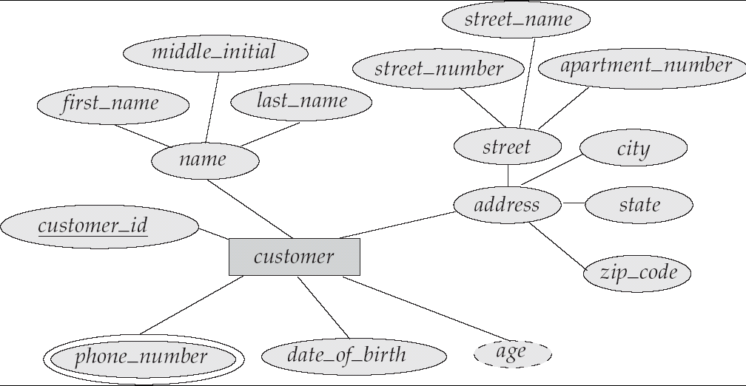

Slide 10
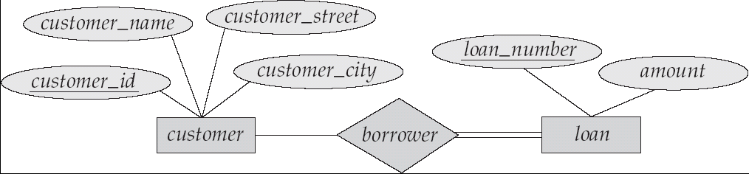
Participation of an Entity Set in a Relationship Set
Total participation (indicated by double line)
E.g. participation of loan in borrower is total
every loan must have a customer associated to it via borrower
Partial participation
Example: participation of customer in borrower is partial

Slide 11
Weak Entity Sets
An entity set that does not have a primary key is referred to as a weak entity set.
The existence of a weak entity set depends on the existence of a identifying entity set
it must relate to the identifying entity set via a total, one-to-many relationship set from the identifying to the weak entity set
Identifying relationship depicted using a double diamond
The discriminator (or partial key) of a weak entity set is the set of attributes that distinguishes among all the entities of a weak entity set.
The primary key of a weak entity=discriminator + primary key of strong entity.

Slide 12
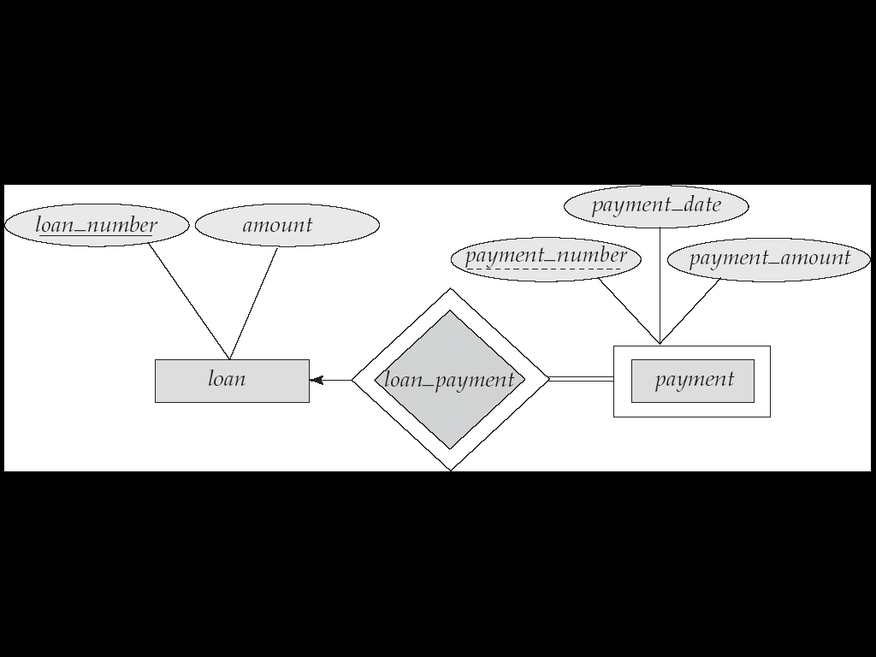

Slide 13
Extended E-R Features
Specialization
Top-down design process; we designate subgroupings within an entity set that are distinctive from other entities in the set.
These subgroupings become lower-level entity sets that have attributes or participate in relationships that do not apply to the higher-level entity set.
Depicted by a triangle component labeled ISA

Slide 14
Generalization
A bottom-up design process – combine a number of entity sets that share the same features into a higher-level entity set.
Specialization and generalization are simple inversions of each other; they are represented in an E-R diagram in the same way.
The terms specialization and generalization are used interchangeably.

Slide 15
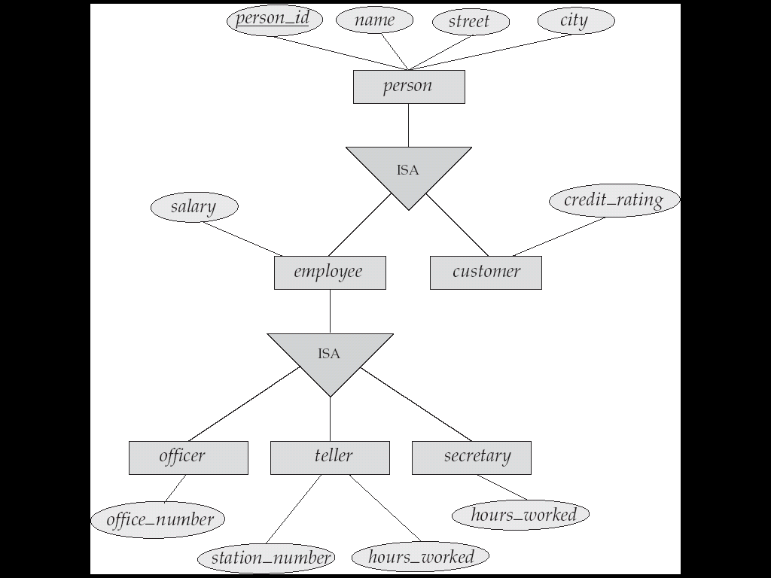
Generalization
Specialization

Slide 16
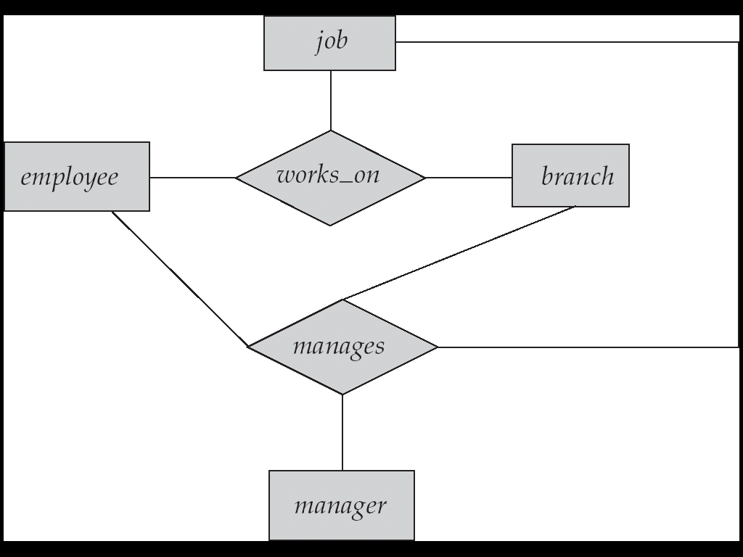
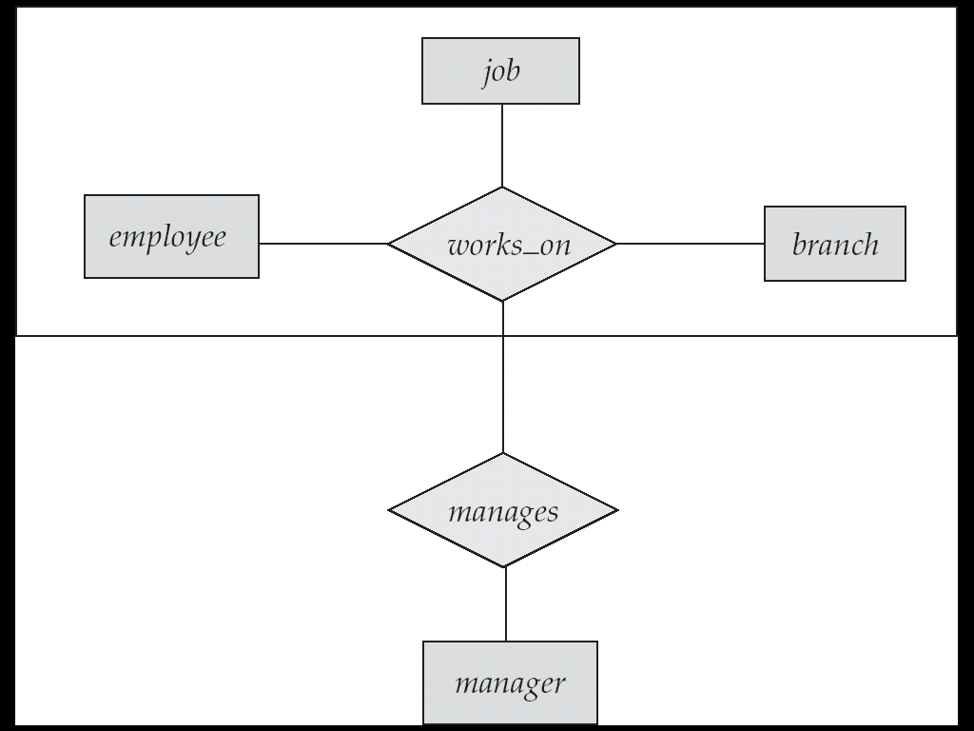
Aggregation
Consider the ternary relationship as

Slide 17
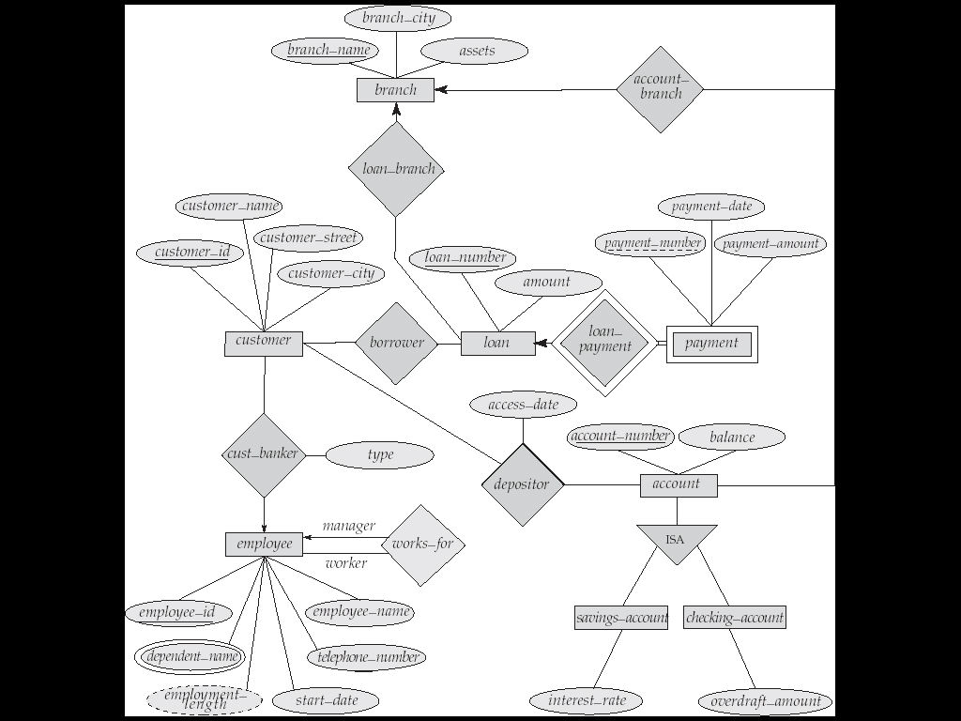
E-R Diagram for a Banking Enterprise

Slide 18
Example
Design an E-R diagram for keeping track of the exploits of your favourite sports team. You should store the matches played ,the scores in each match ,the players in each match and individual player statistics for each match.Summary statistics should be modeled as derived attributes.

